Slide 1
Lesson 11 – Homework review

Slide 2
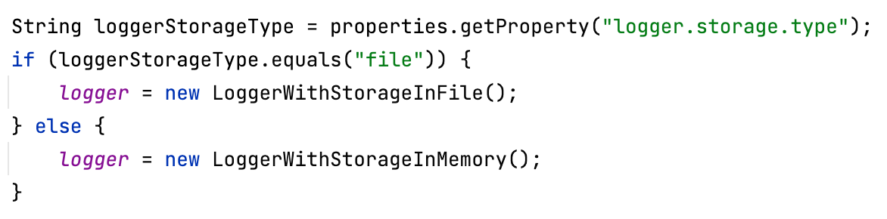


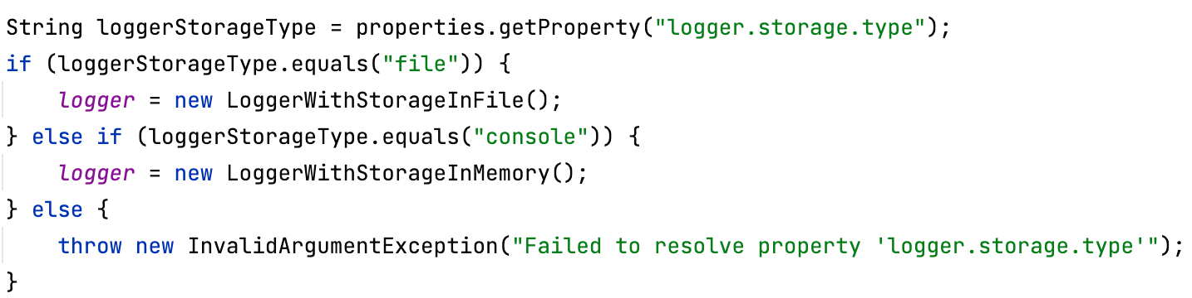
Handle unsupported property values

Slide 3
Use non project-specific paths

Slide 4
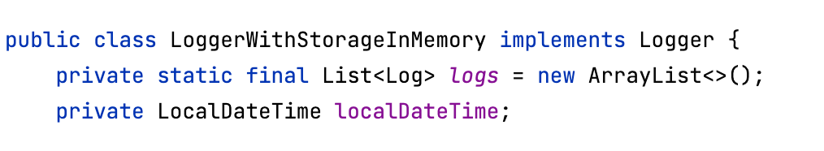
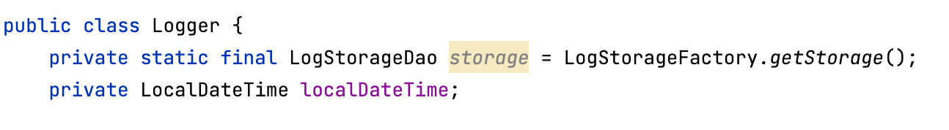
Class responsibility

Slide 5


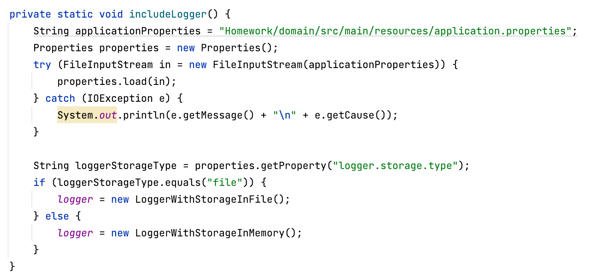
Do not Repeat Yourself

Slide 6
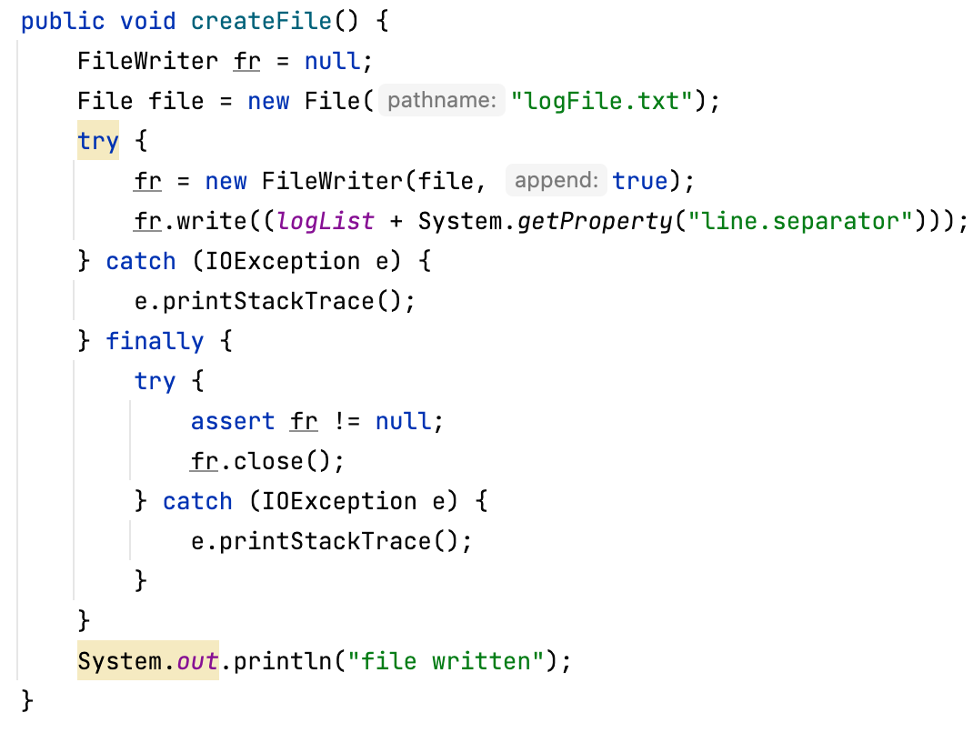
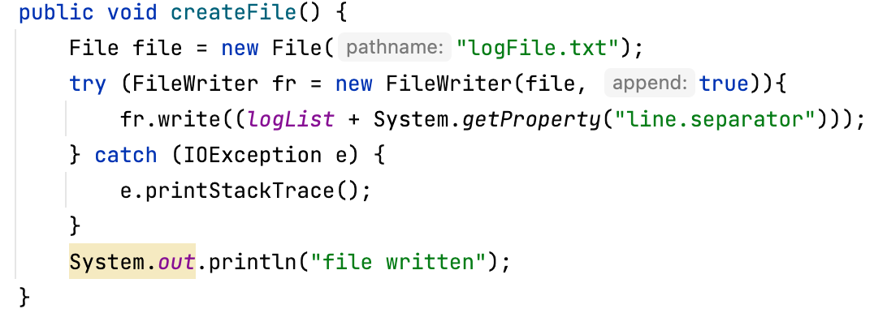
Close resources automatically

Slide 7



Be careful when initializing objects

Slide 8
The end

